Slide 1
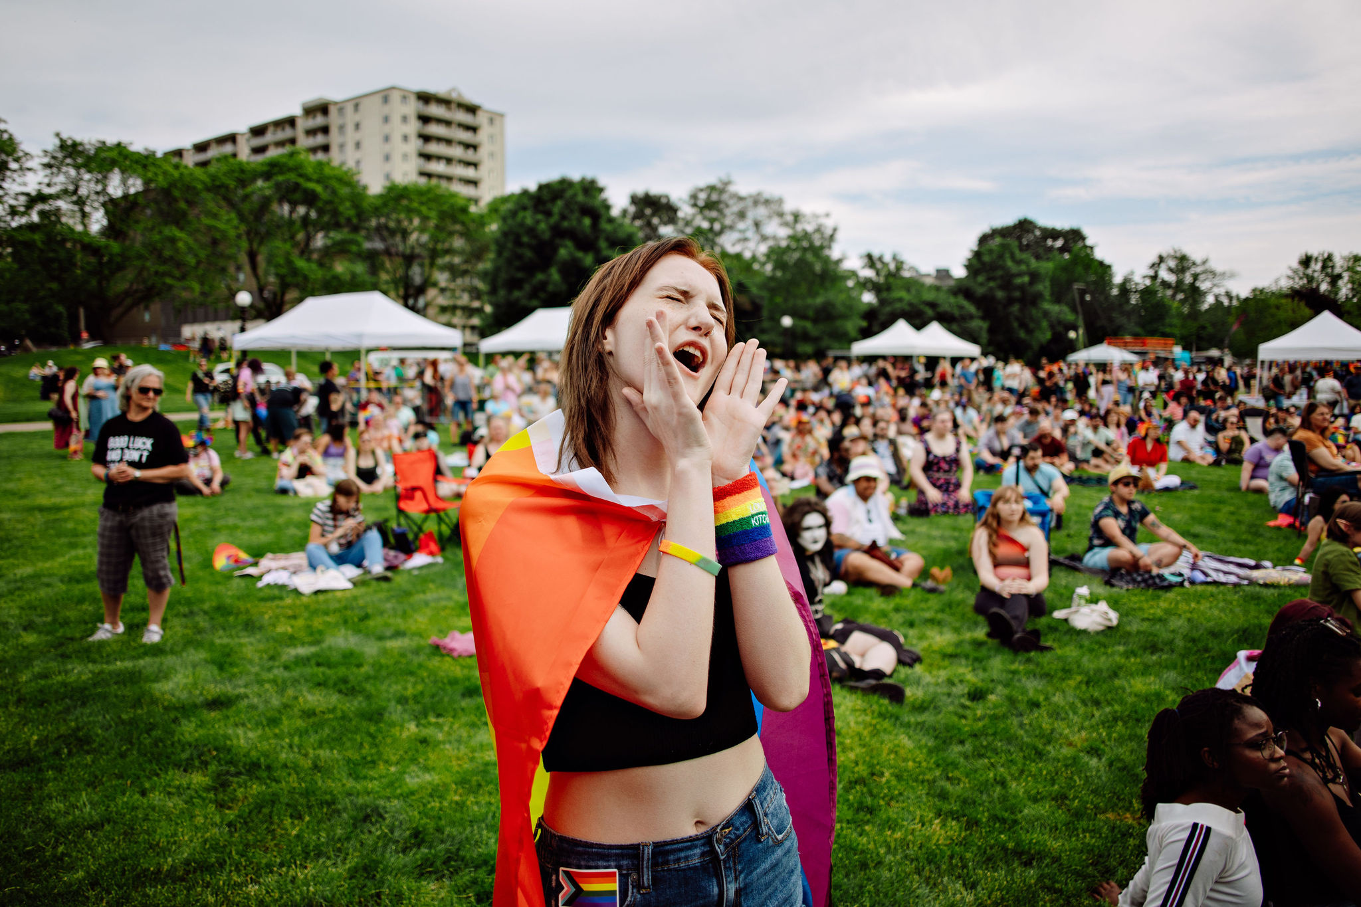

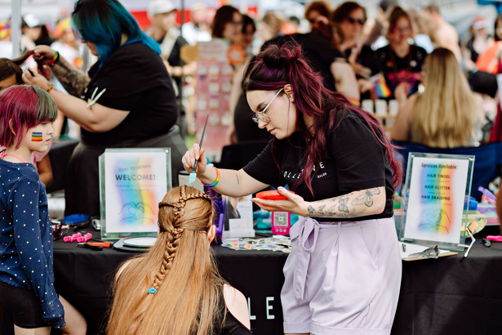

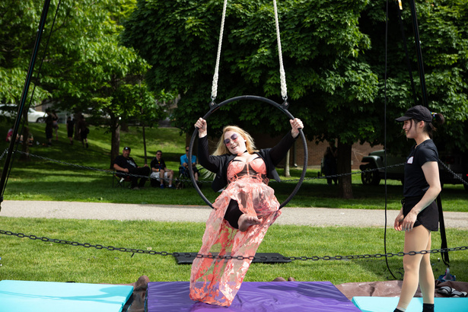
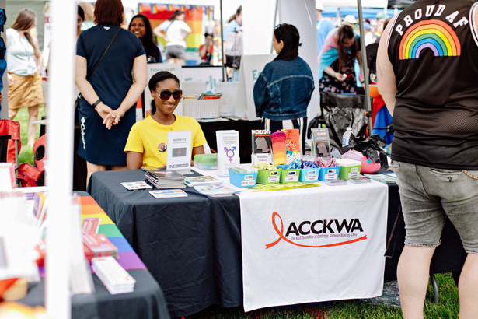
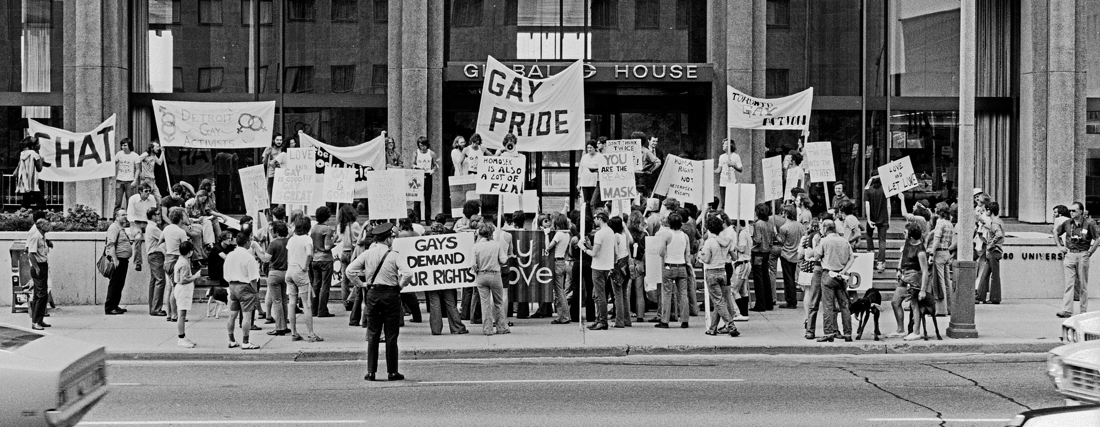

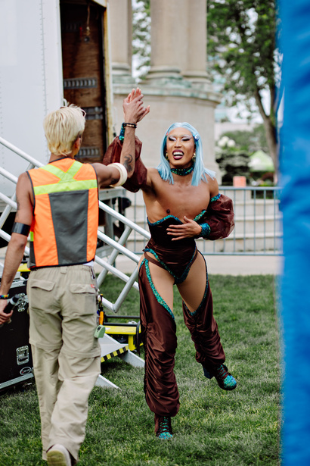
PRIDE guide 2025

Slide 2


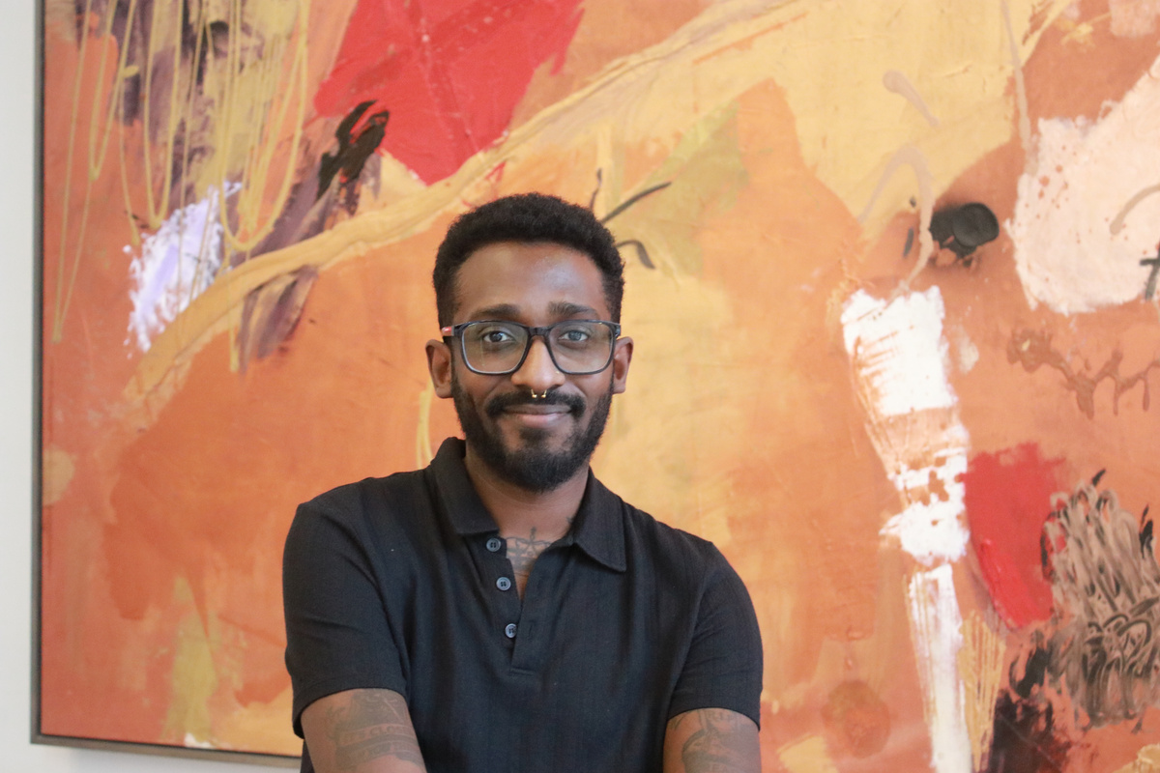
Dear Valued Community Members, Allies, and Partner Organizations,
On behalf of the tri-Pride Board of Directors, I would like to extend our warmest wishes for a joyous and empowering 2025 Pride Season.
The tri-Pride Summer Festival, taking place on June 7th at Willow River Park, is a true labour of love, rooted in resistance and built on hope. It stands as a testament to our shared commitment to the ongoing fight for queer and trans rights and freedoms.
This year’s theme, “Stitching Together Past, Present, and Queer Futures,” reflects our response to the disturbing rise in anti-queer and trans legislation and online hate. Pride began as a protest; not only globally, but right here in Waterloo Region, and we aim to honour the courageous advocacy of those who came before us, while inspiring continued action.
We invite you to join us this Pride Month to celebrate, connect, and build community. Let’s stand together in solidarity, amplify queer and trans voices, and shape a future where everyone can thrive.
With Pride and Gratitude,
Fabian Fletcher (He|They)
President of the Board

Slide 3

presenting sponsor

Slide 4



Slide 5


WITH THE SUPPORT OF

Slide 6
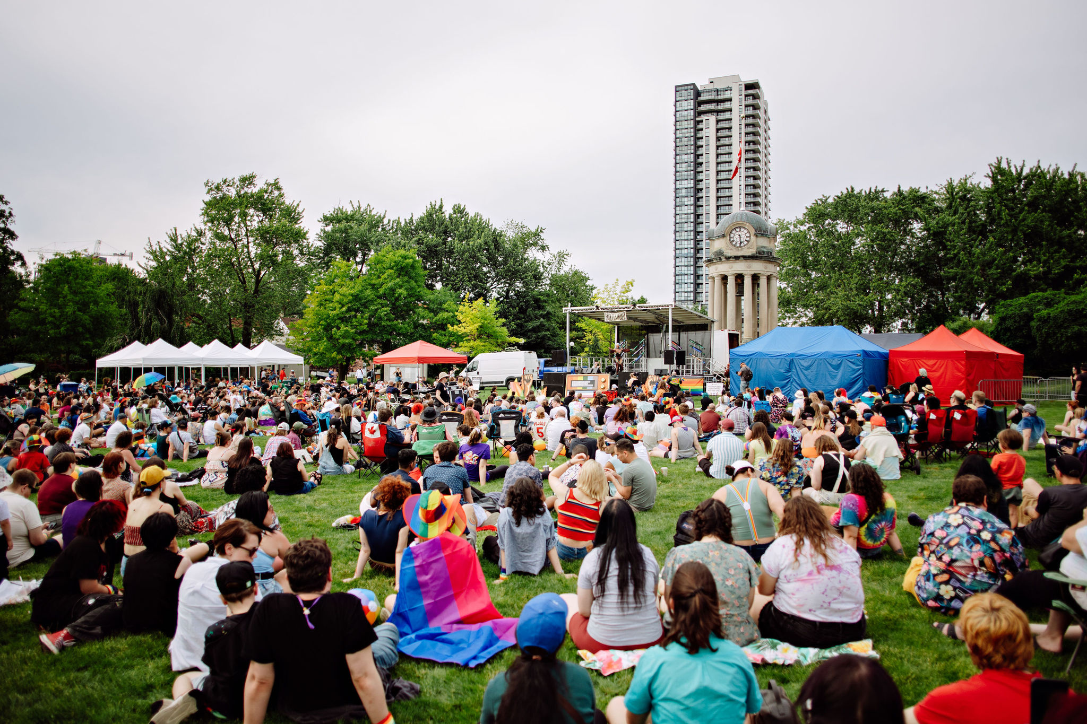













SUMMERFEST
STITCHING TOGETHER PAST, PRESENT & QUEER FUTURES
100+
VENDORS
ALL
AGES
BEER GARDEN
FOOD
TRUCKS
STARRING DENALI
KIDZ ZONE
KARA MELLE | DULCE | ERICK JACKSON & WILLOW RIVER MISS CONDUCT | MELONA | AYESHA AHAD | DIVAA
PEACH BLOSSOM | ELIXXIRR | OLIVER D. SPECTRUM
GEORGE SWOONEY | YU REINAS | MELODY BIJOU
WATERLOO CONCERT BAND | MARLEY MURAWSKY
BOLO TIE LINE | DICKSONMYPOCKET | KINX
JUNE 7,2025 | 12-8PM
Willow River Park
FKA Victoria Park, KItchener

Slide 7
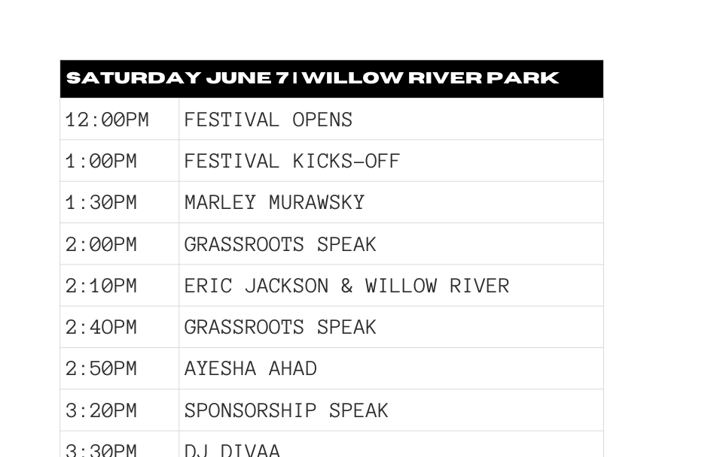


summerfest 2025 schedule
BLACK BUNKER
SYRUS MARCUS WARE
CAFKA x tri-pride
GAUKEL BLOCK | 3-5PM
DURATIONAL PERFORMANCE ART

Slide 8
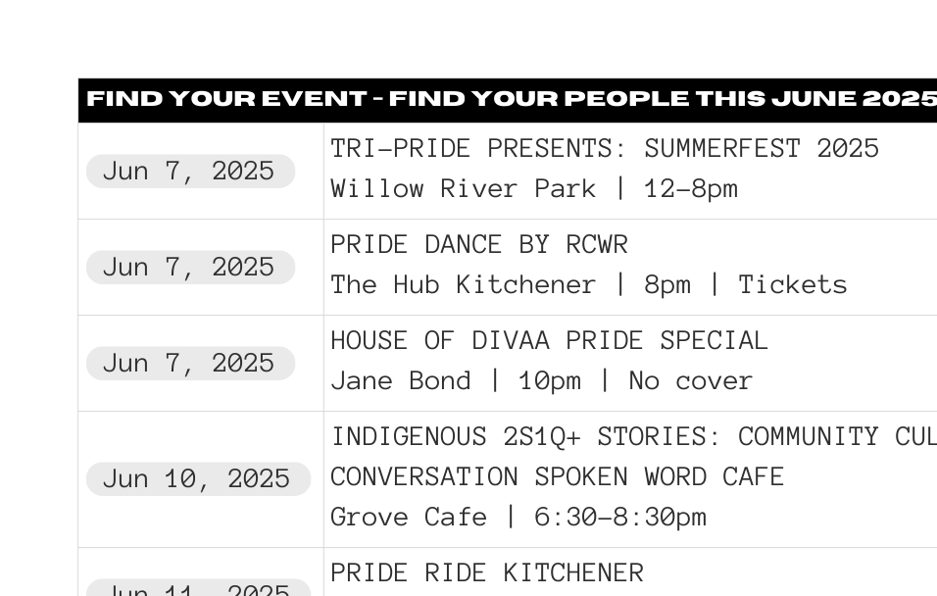
local pride events

Slide 9

local pride events

Slide 10

MENTAL HEALTH & WELLNESS
out of the box counselling & collaborations, kitchener
Two-Spirit, LGBTQIA+, Neurodivergent and Nonspeaking Individuals.
www.outoftheboxcounselling.ca
DM THERAPY SERVICES, KW + GUELPH
I am a South Asian queer transman providing trans-affirming and queer-affirming psychotherapy services to the LGBTQ2S+ community across Ontario.
www.dmtherapyservices.ca

Slide 11
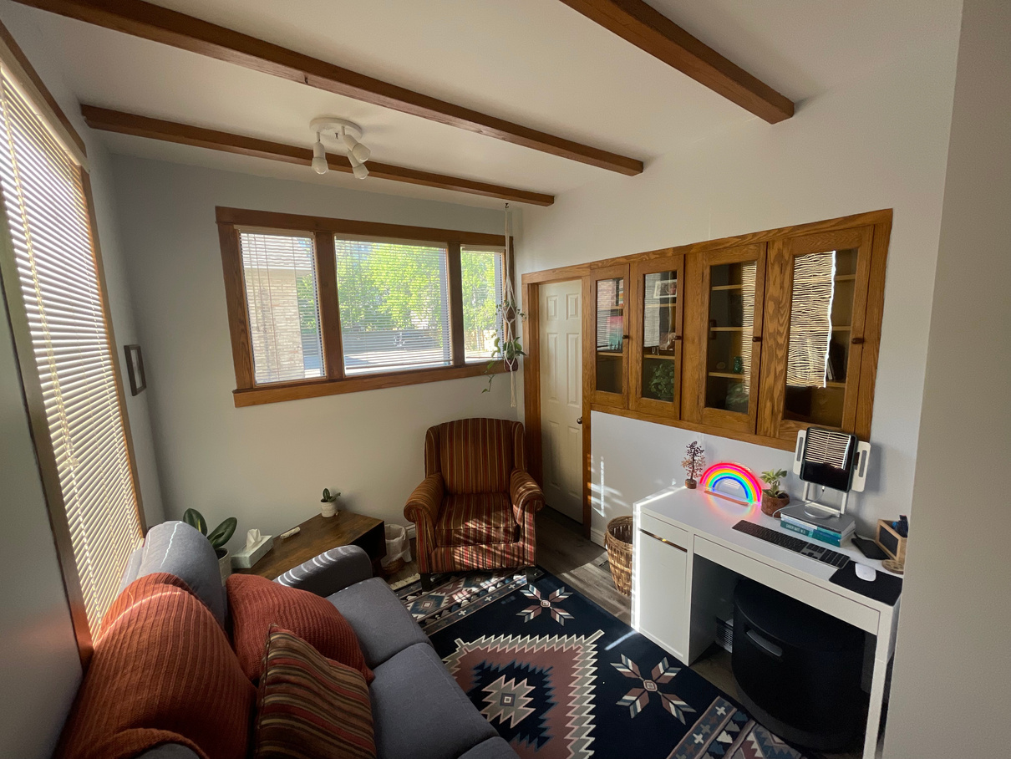
mental health & wellness
STEWART COUNSELLING & PSYCHOTHERAPY
Sliding scale, queer- and trans-informed support.
www.stewartcounselling.com
Affective Wellness (Psychotherapy services), galt
Relational and person-centred therapy with an office conveniently located downtown Galt and offering virtual appointments.
www.affectivewellness.ca

Slide 12
queer affirming services
HONEY EVENTS & DESIGN
HONEY Events & Design is a queer-owned, design-forward event planning studio rooted in creativity, connection, and unapologetic self-expression.
www.honeyevents.ca

Slide 13

advocacy
kw queers for palestine
We are a group of Queer folks who refuse to let our MPs “pinkwash” genocide. We focus on building Queer solidarity for Palestine in the Waterloo Region. Join us and help let MP candidates know: we won’t show up for them, if they don’t show up for Palestine!
@palestinesolidaritykw on Instagram
the transcanada project
Educational resources, sharing the stories of transgender Canadians.
www.transcanadaproject.ca

Slide 14
advocacy
RNAO
RNAO is deeply committed to advancing health equity, inclusion, and social justice.
Through policy advocacy, public education, and member engagement, RNAO works to:
Champion inclusive and affirming healthcare practices
Support 2SLGBTQ+ nurses and clients
Provide tools and resources that promote cultural safety and allyship
www.rnao.ca

Slide 15

advocacy
saving lives with pride
Empowering LGBTQ communities to save lives through inclusive blood, stem cell, and organ donation systems.
www.savingliveswithpride.com
elderdog k-w
ElderDog Canada is a national charity that helps older folks keep their dogs by providing free dog care support, short-term fostering, and long-term and perpetuity care for seniors who can no longer keep their dogs. ElderDog is proud to support 2SLGBTQIA clients and be served by volunteers from the 2SLGBTQIA community.
www.elderdog.ca/about

Slide 16
queer inviting CHURCHES
first united church, waterloo
www.firstunitedchurch.ca
parkminster united church, waterloo
www.parkuc.ca
elevation church., WATERLOO
www.elevationwaterloo.org

Slide 17
OTHER
bread and roses housing co-op, kitchener
Nonprofit housing celebrating diversity.
Market wait list is accepting applications.
www.breadandroses.coop
murdoch travel, WATERLOO
As a gay owned travel agency, we're here to help our community and avoid the pitfalls that can be associated with modern travel. We bring experience and that human connection to travel planning.
www.murdochtravel.ca

Slide 18

IN-KIND SPONSORS
kw surplus
canadian tire, sunrise centre
the community edition
soapopular
victoria party store

Slide 19
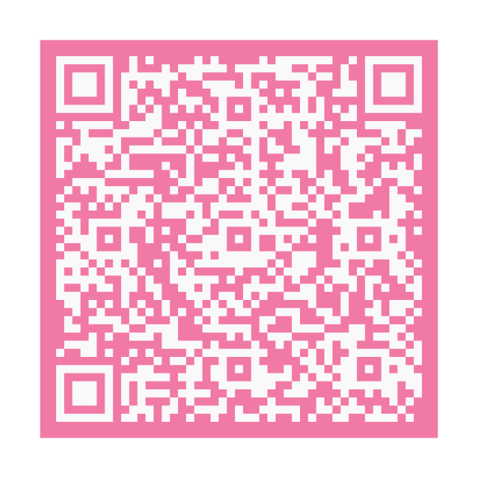
summerfest 2025 FEEDBACK FORM
TELL US WHAT
YOU THINK

Slide 20
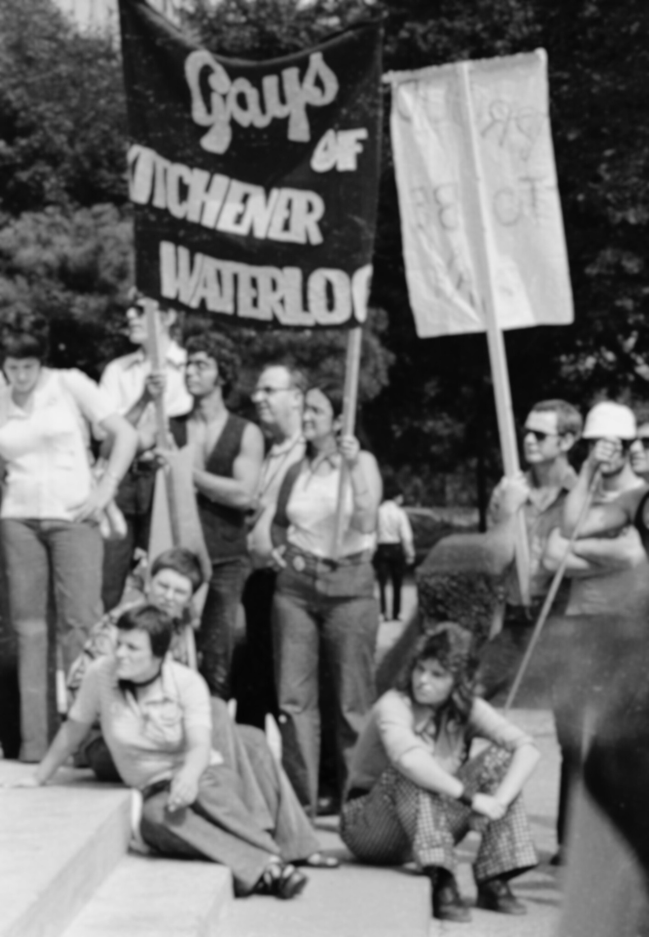
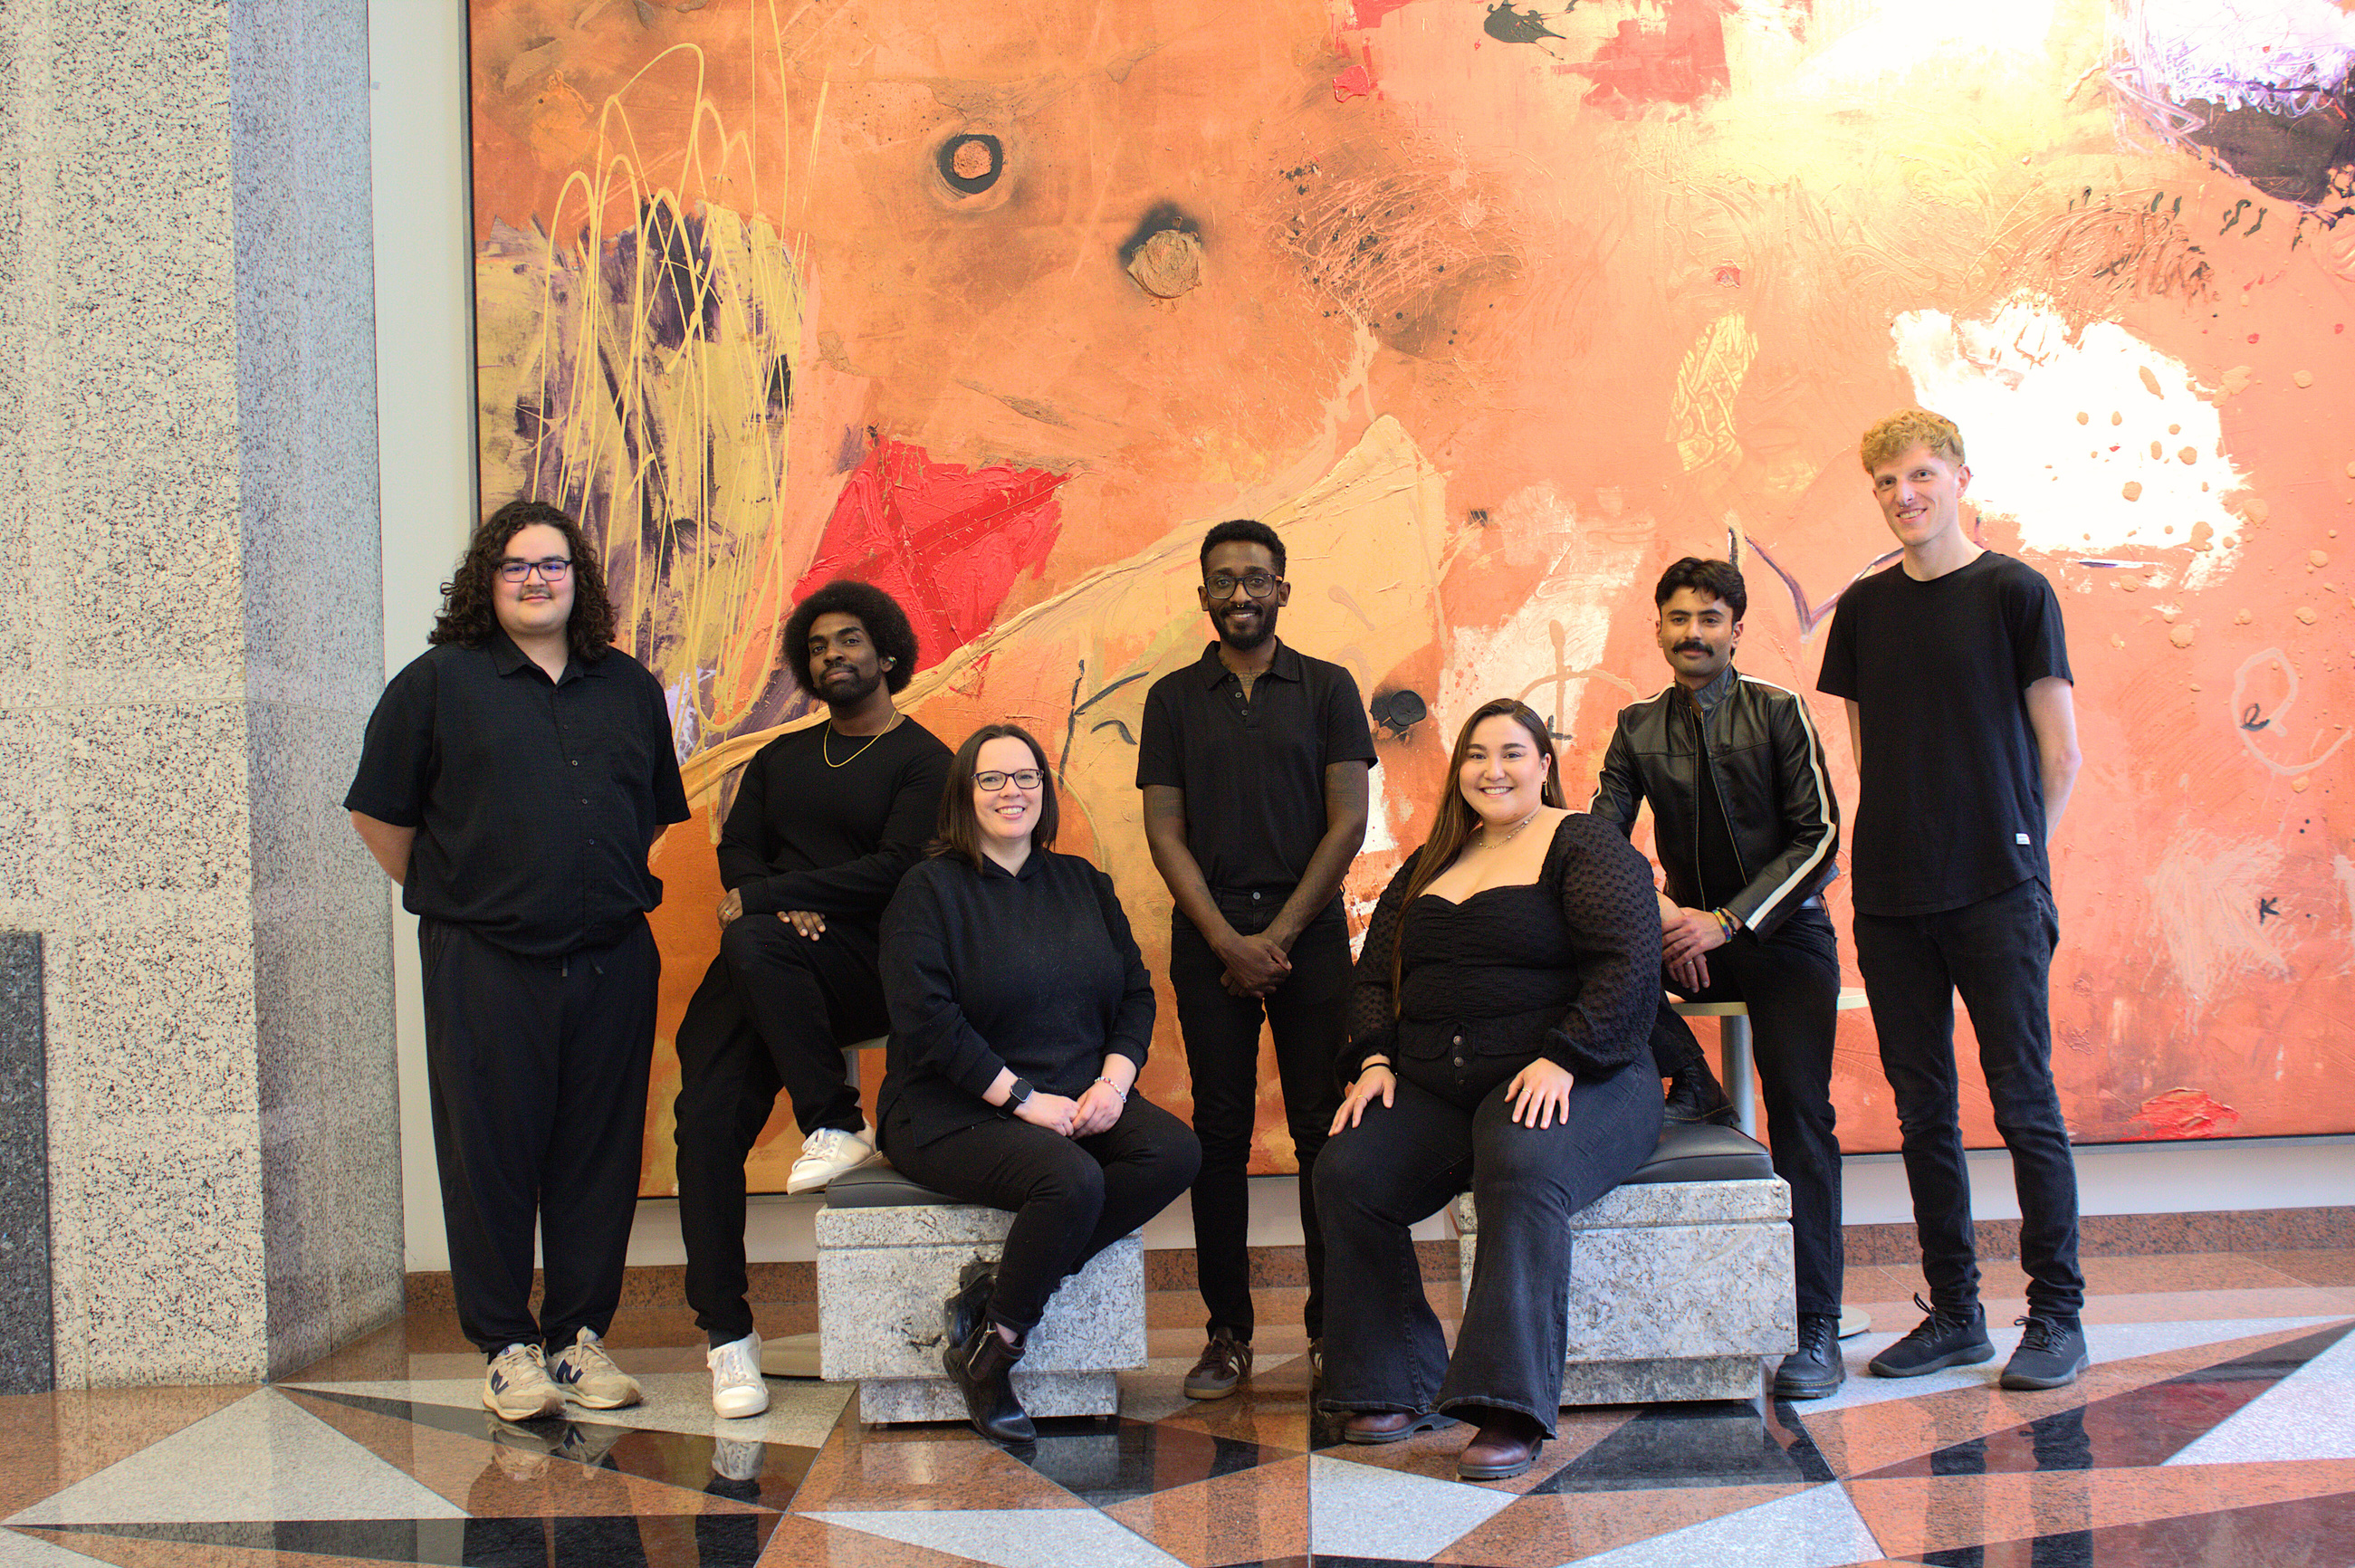

THIS IS TRI-PRIDE

